Slide 1
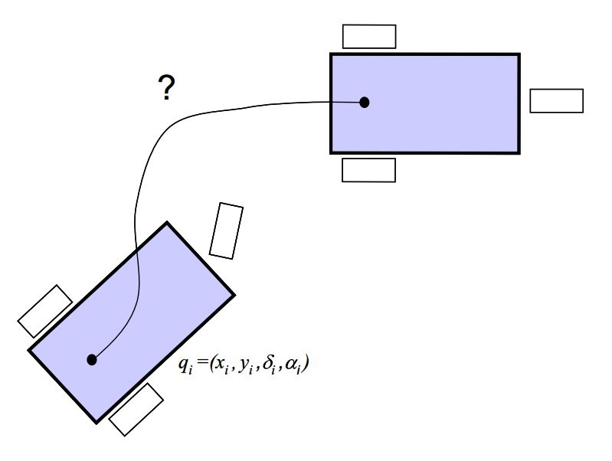
Point to Point Path Planning
Gabriele Minotto, Prof. Mariolino De Cecco

Slide 2
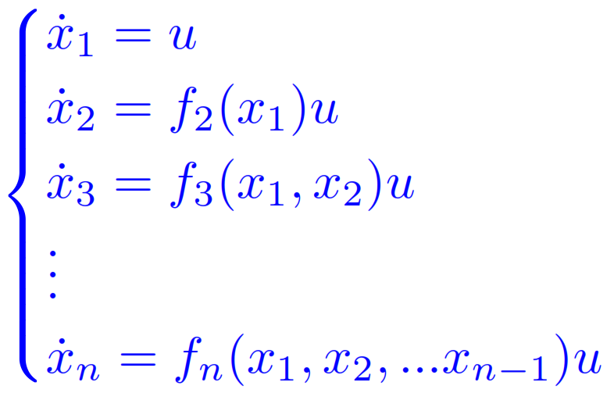
Systems in "chained form"
This formulation allows a simple integration of the kinematic equations:

Slide 3
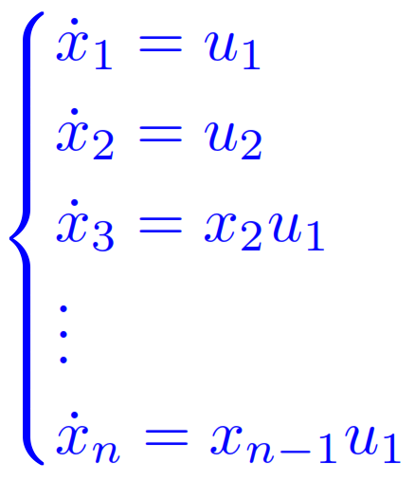
In the case of two inputs, we have the single chain (2,n), which are always controllable and nilpotent. Input u₁ is called "generator", variables x₁ and x₂ are called "base variables".

Slide 4
If u₁ is constant the system is linear and completely controllable, but it can work well also with other type of functions, like polynomials.
To transform in chained form we must:
Change the coordinates, such as x=Φ(q) ;
Change inputs, like ν=β(q) .
It is possible to demostrate that a non holonomous system with m=2 inputs and n=3,4 generalized coordinates can always be casted in chained form.

Slide 5
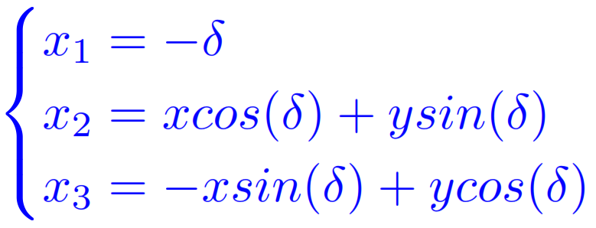
1) Monocycle model
Where v is the wheel velocity, w the steering velocity. Using the trasformation of coordinate, which provide us the Cartesian coordinates of the unicycle expressed in the body reference system:

Slide 6
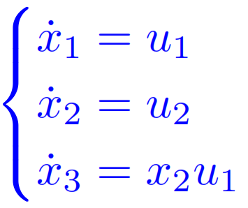
and the input transform:
we obtain the following chained form:

Slide 7
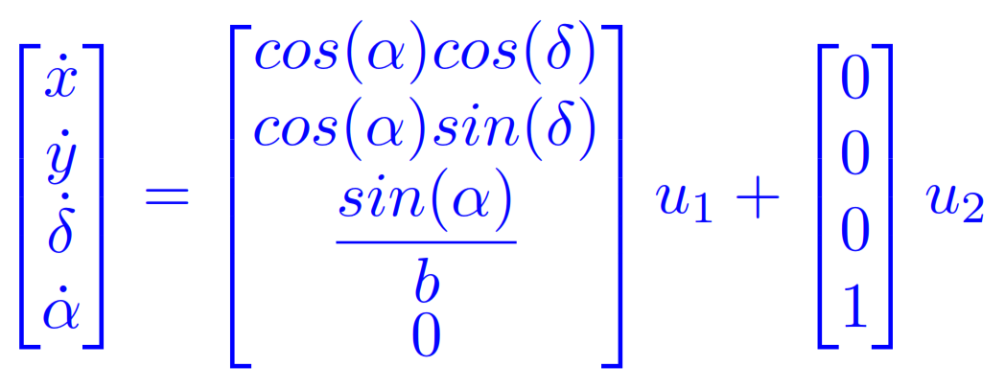
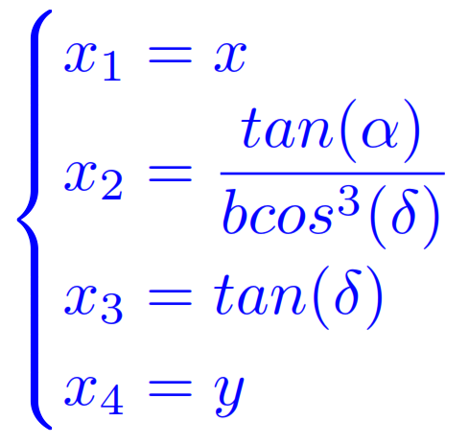
2) CAR-LIKE model
Where u₁ is the front wheel velocity and u₂ the steering velocity. In this case we use as new coordinates:

Slide 8
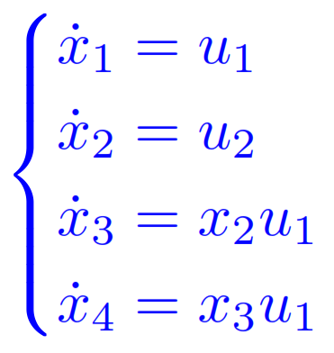
and as inputs:
and then we obtain the following chained form (defined for δ ≠ π/2 ± kπ, k ϵ Ν):

Slide 9
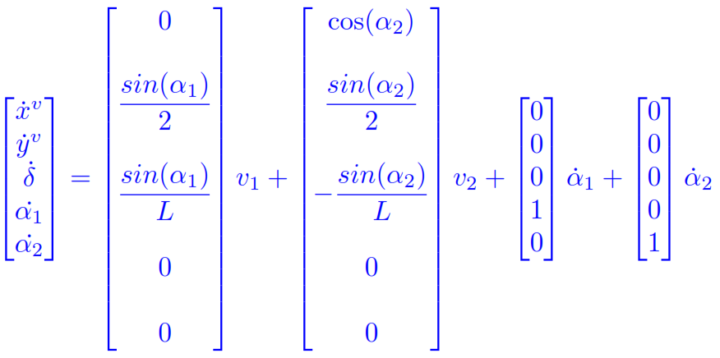
3) RHOMBIC-LIKE MODEL
Here the kinematic model of rhombic-like vehicle, expressed in vehicle’s reference frame.

Slide 10
Where v₁ and v₂ are the traction speeds, ά₁ and ά₂ the steering velocities, respectively of front and rear wheels.
And the chained form…..
IT’S UP TO YOU!!!!!!
SUGGESTION: to find a chained form for the rhombic-like vehicle, use the kinematic model of previous slide, defined in vehicle’s reference frame, in order to not complicate too much the computation.
Don’t forget the kinematic constraint of velocities!

Slide 11
Methods to steer a vehicle point to point starting from the chained form
It occurs that also the chained system is not holonomous but in this case you can use appropriate procedures to obtain classes of solutions to the problem of motion planning of point-to-point, or trajectories (motion laws) that giude the robot from a starting configuration to another one with assigned coordinates.
It is possible to use different kind of inputs, like sinusoidal, piecewise constant and polynomial functions.

Slide 12
1) Piecewise constant inputs
In this case we divide total time T in subintervals of length Δ where both inputs are constants:
It is possible to mantain u₁ always constant and take n-1 intervals (k = 1,…,n-1) so that:

Slide 13
where n is the number of generalized coordinates, x_{f1} and x₀₁ are respectively final and initial values of first coordinates x₁.
The n-1 constants values (u_{2,1}, u_{2,2}, …, u_{2,n-1}) of u₂ are obtained by solving a linear system, computed after integration of the chain and imposition of initial and final conditions.
In the case of coincidence between initial and final abscissa’s value, it is necessary to add an intermediate point, and it’s also impossible to carry out manoeuvres with automatic speed inversion.
One of this method’s drawbacks is the fact that steering speed may present discontinuities.

Slide 14
2) POLYNOMIAL INPUTS
This method, which use polynomial functions as inputs, is characterized by better performances in terms of input functions’ continuity ("smoothness").
But we can increase the degree of polynomial, in order to have more degrees which allow us to avoid eventually present obstacles.

Slide 15
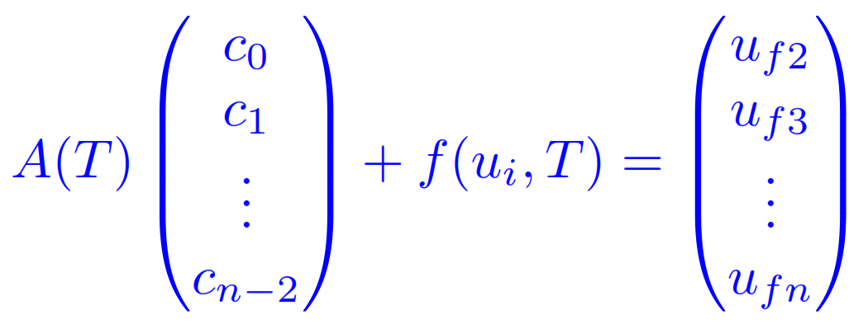
By integrating the chain and imposing initial and final conditions, we will obtain a linear system into the unknowns (c₀, c₁, …, c_{n-2}):
A(T) can be inverted for T≠0.
Also in this case if abscissa’s initial and final points coincide we must add an intermediate point, and we cannot carry out manoeuvres with automatic inversion of the speed.

Slide 16
Work in class
1) PATH PLANNING
Drive a vehicle from pose [0, 0, 0] to [1, 1, pi/2] in T=1s, where the three coordinates are [x, y, δ]. For a car like add the steering angle that you prefer.
Choose monocycle, car-like or rhombic-like model and consider its chained form.
Choose piecewise constant or polynomial inputs.

Slide 17
Then:
Compute initial and final conditions in the transformed coordinates .
Divide the time interval T in n-1 intervals (n equal to the number of generalized coordinates).
Find input u₁ in explicit form and u₂ in symbolic form for the n-1 intervals.
Integrate symbolically the chained form equations starting from x₁ in order to obtain x_{i}(t), i = 1…n.
Constrain with the initial and final conditions to find a linear system in the symbolic piecewise constant u₂ inputs (polynomial coefficients in the other case).

Slide 18
Solve for the u_{2i} unknowns.
Substitute the u_{2i} values to obtain x_{i}(t).
From the coordinates transform equations find the generalized coordinates (x, y, δ for the monocycle and x, y, δ, α for the car-like).
From the input transform equations find the two inputs as a function of time.
Plot the resulting trajectories/paths in the 2D space and inputs as a function of time.

Slide 19
Once finished the above steps, you can consider the following:
Compare the results with other inputs.
Add to the polynomial input one order and choose the resulting degree of freedom to change your path (imagine an application of obstacle avoidance).

Slide 20
2) OPTIMIZATION ALGORITHMS
A) Minimization of distance from a set of points like obstacles
Define Oi = [xi, yi]^{T} i=1…n point obstacles.
Define symbolically the polynomial’s parameters.
For every Oi choose a Pi on the trajectory (or find the one with minimum distance).
Build a functional that uses the distances of Oi from Pi.
Minimize this functional.
Try to change the degree of polynomial that you choose as degree of freedom.
Try to add obstacles and degrees of freedom (as coefficients to the polynomial).

Slide 21
B) Minimization of length of path in the presence of obstacles
Choose the right target to minimize in order to find the shortest path that can be performed by vehicle…
IT’S UP TO YOU!!!!!!

Slide 22
SOFTWARE SUGGESTED FOR COMPUTATIONS:
MAPLE™
SUGGESTION: use often Maple Help!

Slide 23
1) PATH PLANNING
MONOCYCLE MODEL
A) Using piecewise functions
B) Using polynomial inputs

Slide 24
MONOCYCLE MODEL: PATH PLANNING
> # Clear and close all previous work.
restart: with(plots): with(LinearAlgebra):
> # Data Inputs.
data := [T = 1, n=3];
Model definition (here we introduce models in matrix form < > or in list form [ ]):
> eq_tr := <x__1(t) = -delta(t), x__2(t) = x(t)*cos(delta(t)) + y(t)*sin(delta(t)), x__3(t) = -x(t)*sin(delta(t)) + y(t)*cos(delta(t))>;
> eq_v := [v__1(t) = x__3(t)*u__1(t) + u__2(t), v__2(t) = -u__1(t)];
> in_cond := [0, 0, 0]; fi_cond := [1, 1, Pi/2];

Slide 25
1) Initial transformed conditions
>in_tr_cond := convert(evalf(subs(x(t)=in_cond[1],y(t)=in_cond[2],delta(t)=in_cond[3],eq_tr)),list);
> fi_tr_cond := convert(evalf(subs(x(t)=fi_cond[1],y(t)=fi_cond[2],delta(t)=fi_cond[3],eq_tr)),list);
2) Divide time int.
> n_i := subs(data,n-1);
> delta_T := subs(data,T/n_i);

Slide 26
A) Using piecewise functions:
3)Input u__1 e u__2 in symbolic form: ‘convert’ operation is useful to extract informations from piecewise functions. It may be useful to convert MATRIX in LIST.
> u__1s(t) := (x__f1 - x__i1)/T; #symbolic form
> u__1(t) := subs(data,x__f1=rhs(fi_tr_cond[1]), x__i1=rhs(in_tr_cond[1]),u__1s(t));
> u__2(t) := piecewise(0 <= t and t <= delta_T, u__21, delta_T <= t and t <= n_i*delta_T, u__22);
Substitute chosen inputs in the chain, with commands previously defined, and integrate all of them (see ‘int’ command).

Slide 27
It may be common to group all of generalized coordinates in an unique list:
> # Generalized velocities and positions.
> vel_gen := [op(diff_ui(t)), op(diff_u3(t))];
> pos_gen := [op(x__i(t)), simplify(x__i3)];
4 -5) Constraint initial and final conditions - linear system. Then solve for the u__2i unknowns.
It may be common to substitute T in piecewise functions and match them to the final conditions. See ‘solve’ and ‘evalf’ commands.

Slide 28
6) Obtain x__i(t) from u__2
???
7) Obtain generalized coordinate x, y, delta
???
8) Find the two inputs
???

Slide 29
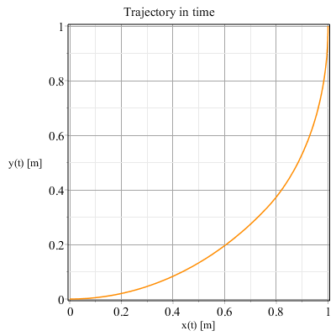
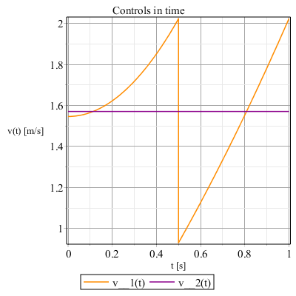
9) Plot trajectories & controls
See ‘plot’ and ‘display’ commands, in order to plot trajectory in the plane (x,y) and controls in time.
Plot solutions:

Slide 30
Compare the results with other inputs.
NOTES: third initial and final conditions (related to δ) must not be the same, because equation related to x3(t) is always equal to zero and another setting of piecewise equations must be performed.
Remember also previous notes about efficiency of this method.

Slide 31
B) Using polynomial inputs:
We can use the previous Maple sheet, simply modifying the input u₂.
Since the linear system of 2 equations can have more than 2 unknowns (as we said in the related slide), you must choose a ‘first guess’ value for those in excess, in order to solve the system and find the last two coefficients.

Slide 32
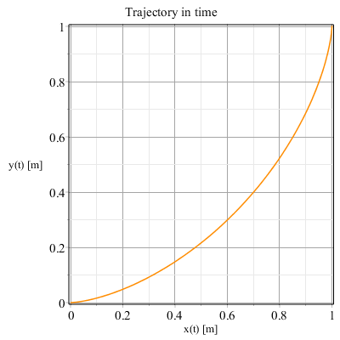
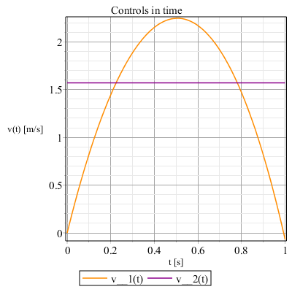
9) Plot trajectories & controls

Slide 33
NOTES: if third initial and final conditions are the same, there is only one unknown polynomial constant, because one equation with final conditions is always satisfied and all the other constants must be defined a priori.

Slide 34
2) OPTIMIZATION ALGORITHMS
A) Minimization of distance from a set of points like obstacles
B) Minimization of length of path in the presence of obstacles

Slide 35
OPTIMIZATION ALGORITHMS
In these cases we must define the obstacle’s positions:
> Obs_Pos_Data := [ xp__1 = 0.8, yp__1 = 0.8, xp__2 = 0.2, yp__2 = 0.2 , xp__3 = 0.3, yp__3 = 0.7 ]: <%>:
And some other data parameters, like n_OP (number of obstacles), ε (minimum distance from path to obstacles), n_P (number of integration substeps for defining the target to minimize), T__step (time at which vehicle must pass between two obstacles).

Slide 36
SUGGESTION: define also u₁ as a polynomial input, in order to increase the smoothness of solution.
Prepare the Optimization:
A) Target is the distance between path and the obstacles’ positions. Bound is the linear system with final conditions.
B) Target is the trajectory of vehicle, which length is to minimize. Bounds are the linear system with final conditions and a minimum distance from obstacles ε.
See ‘Optimization’ in Maple Help.

Slide 37
A) Minimization of distance from a set of points like obstacles
SUGGESTION: in this optimization we want the vehicle passing through two obstacles close toghether at a certain time. For this reason we want to define the constraint of optimization as the euclidean distance between themselves and the car at a determined time: obviously, if we have two couples of obstacles, we will define two time to which vehicle will pass thorugh them, one for the first couple and one for the second couple, and so on.
> T__step := subs(data,[T/4, T/4, 2*T/4, 2*T/4, 3*T/4, 3*T/4]):

Slide 38
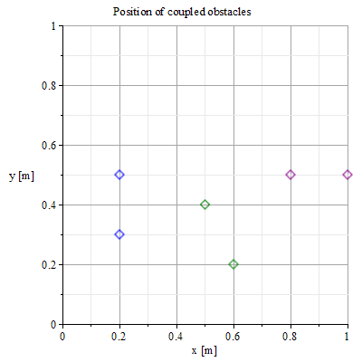
Position of couples of obstacles, with related passage time.
(x_{p1},y_{p1}) → t = T/4
(x_{p3},y_{p3}) → t = 3*T/4
(x_{p2},y_{p2}) → t = 2*T/4

Slide 39
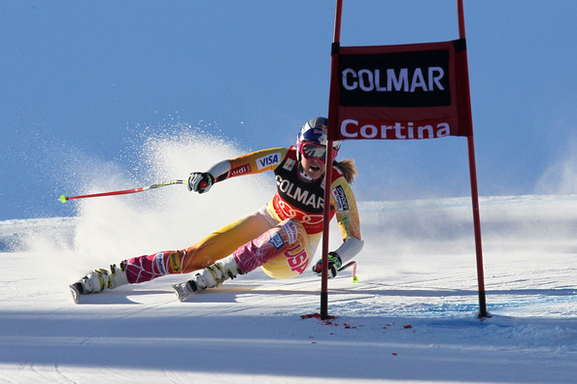
Plot procedure is similar to previous exercise, only with some more features (see ‘plot options’ in maple help).
If your computation works well, you could have a vehicle that makes ‘slalom’ between obstacles!!!
Lindsey Vonn, Audi FIS World Cup - Women's Super Giant Slalom

Slide 40
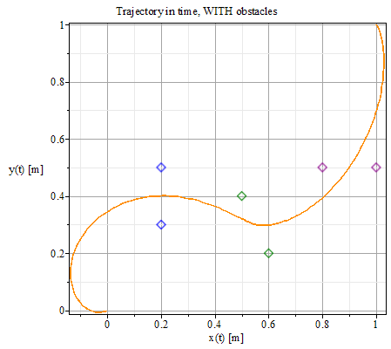
RESULTS: in this case we have taken symbolically also initial and final attitudes, in order to increase the smoothness further (to plot obstacles, see ‘pointplot’ command).
Improve this work, by passing the vehicle between two obstacles with a trajectory orthogonal to the line which joins them!!

Slide 41
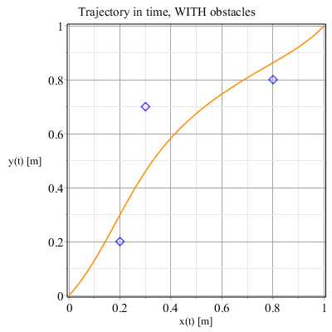
B) SUGGESTION: in order to reduce the computation time, you can define the target with the rectangle method instead of the common integral (see ‘sum’ command).
RESULTS (i.c. = [0,0,π/4], f.c. = [1,1,π/4] ):

Slide 42
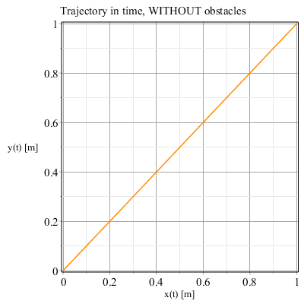
To verify that path optimization works well, remove obstacle bounds and impose as initial and final conditions respectively [0,0,π/4] and [1,1, π/4]. Result must be a straight path, then without attitude variations:

Slide 43
AND THE NEXT STEPS????
-) Car-like model …
-) Rhombic-like model …
IT’S UP TO YOU!!!!!!
SUGGESTION: for the rhombic-like vehicle, remember to work always in the vehicle’s reference frame, and only after the optimization return to the ground!!

Slide 44
BIBLIOGRAFY
Prof. Mariolino De Cecco - slides of Robotic Perception and Action course.
Luca Baglivo - Navigazione di Veicoli Autonomi: Pianificazione e Controllo di Traiettoria

